Slide 1

E – Society Management System Website.
BY:
Madhavi Jyothi Kolagatla
Priyanka Singh
Shivani Panjwani
Shivam Sahu
This Photo by Unknown Author is licensed under CC BY-SA-NC

Slide 2
The Housing Society is web application that manages society by houses with Members details and Service providers
In this website we provide platform to register a society to our system, and there are many houses according to each society. Each house allocated to owner of the house, all the owner are the members of our project. We have given platform to service provider to register their services here. We have given the business outlets here, society member can take appointments to doctors from here, they can book their gas from here and many more facilities.

Slide 3
Home Page
Add new Society member
Show all Society member
Insert new Service Provider
View all Service Provider
View Profile
ADMIN
yes
yes
LOGIN
yes
View all Services
Gas Booking
Hospital Services
Business Outlets
Events
yes
SOCIETY MEMBER
No
Incorrect
Credentials

Slide 4

N- Tier Architecture
DATABASE (TABLES)
ENTITY LAYER
DALEF (MODELS) & IMPLEMENTING INTERFACE
SERVICE LAYER (CONTROLLER)
IDATABASE (INTERFACE)
ANGULAR UI (Client Side)
WEB API HOSTING (Server Side)

Slide 5
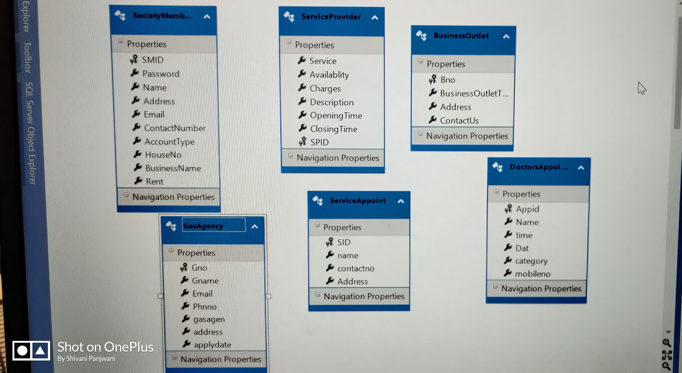
ENTITY FRAMEWORK(.EDMX FILES)

Slide 6
TECHNOLOGY : Visual Studio and VS Code with C# Language
WEBAPI and Angular
DATABASE: SQL Server

Slide 7
Learning Process:
We Have started from basic concepts like C#, oops, html , xml. Completed small projects with the help of Windows Form, MVC, ado.net, asp.net, angular components.
Have learned html, basic and advance SQL queries and many more things.
We learnt Java script and done some very good pages and website of our own.
.NET is very enjoyable from start to finish, and the things you can accomplish using different controls and methods.
It was a 60 days journey and this made us so comfortable and enthusiastic in learning new technologies , executing them in there better version.
The assignments and mini case studies helped us to boost our confidence.

Slide 8
Different Projects which we have done in Training.
Student Management System (Windows form with N- Tier Architecture)
Vehicle Parking System (with the help of Asp.net).
Pizza Ordering System (with the help of MVC).
Library Management System(with the help of Angular).

Slide 9
Vote of Thanks
Finally I would like to take this opportunity to place on record our heart thanks to “TeamLease University” for sharing recorded sessions timely and also for answering our queries whenever we required.
Further we are to our beloved mentor “Deepa ma’am” for her guidance and for giving an excellent coverage to DotNet training through the hands-on projects. Thank you so much ma’am for debugging our errors every time , make us to love coding.
We would also like to extend our gratitude to our batchmates who always support us to complete our projects.

